Slide 1

Proposal Defense
Socratic AI: Agentic AI for Fostering Critical Thinking Education
A multi-agent tutor that asks instead of answers, and measures how well the learner reasons
Presented by : Eusoff Amir ([Student ID])
Supervised by : Dr Ho Tatt Wei
Internal Examiner : [Name]
Course : [Course code] Final Year Project I
Project code : 26S004
Date : 21st October 2026
Notes:
Good afternoon. My name is Eusoff, and my supervisor is Dr Ho Tatt Wei. My project is Socratic AI, an AI tutor that does not give answers. It asks questions step by step and measures how well the student reasons.

Slide 2

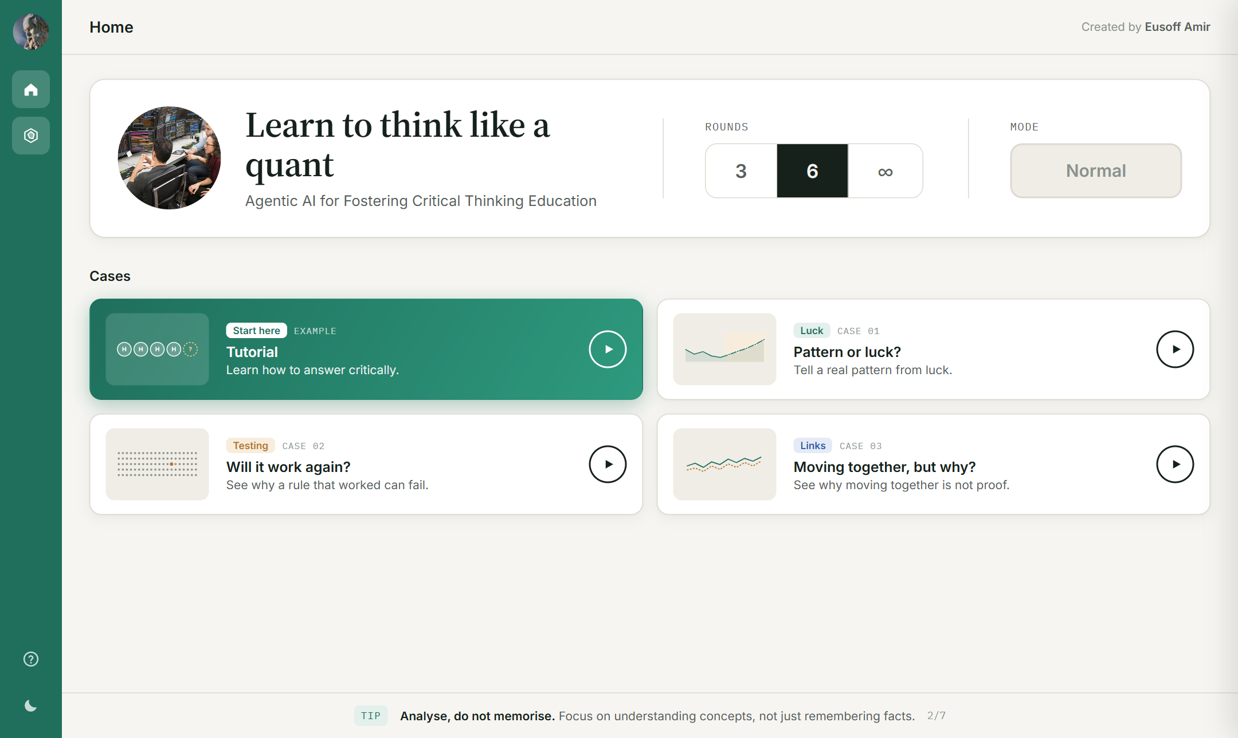
OUTLINE OF PRESENTATION
1
Introduction
2
Problem Statement, Objectives, Scope of Study
3
Literature Review
4
Proposed Methodology
5
Gantt Chart & Milestones
The working prototype, live online
6
Preliminary Results
7
Conclusion
2
Notes:
This is my outline. I will cover the introduction, the problem, objectives and scope, the literature, my methodology, the timeline, my first results and the conclusion. On the right is the working app, which is already online.

Slide 3
INTRODUCTION
Generative AI now gives students a finished answer in seconds, so they can skip the thinking.
62%
319
4
of students use generative AI at least weekly [12]
knowledge workers studied: more trust in AI meant less critical thinking [10]
costs of "outsourced reasoning": fewer ideas, less effort, weaker memory, less reflection [11]
The idea of this project
Turn the same AI around. Instead of an answer machine, build a tutor that asks Socratic questions in a set order, so the learner builds the understanding, and then measure the quality of the learner's reasoning against a framework.
3
Notes:
Students can now ask an AI for a finished answer and copy it. A QS report found 62 percent of students use generative AI every week, and a study of 319 workers found that people who trust AI more think less critically. My idea is to use the same AI the other way round: a tutor that asks questions in a set order, and that measures how well the student reasons.

Slide 4
PROBLEM STATEMENT
Two Gemini Gem tutors were tested (an online Socratic Tutor and the first project prompt). Three problems were found.
1
2
3
No structure
No assessment
Poor experience
Questions do not climb step by step from clarifying to questioning the question itself.
The tutor cannot say how well the learner reasoned against any framework.
It repeated questions, forgot answers, ignored frustration and never said when it would end.
Real tester messages: "bro i explained this before" and "you are asking way too much follow up questions"
So a single Socratic prompt is not enough. The tutor needs a structured ladder, a separate assessor, memory, and a clear goal, progress and end.
4
Notes:
Some tools already refuse to give answers, like Gemini Gems. I tested two of them and found three problems. The questions have no structure, there is no real assessment of reasoning, and the experience is poor. My tester wrote: bro I explained this before. So one prompt is not enough.

Slide 5
OBJECTIVES
1
To design and build Socratic AI, a multi-agent tutoring prototype that teaches beginners one quant topic through Socratic dialogue.
2
To guide the tutor through six levels of Socratic questioning, and to assess the learner with the nine intellectual standards.
3
To show which type of reasoning (inductive, deductive, abductive) and which types of knowledge the learner used, measured over many questions.
4
To adapt the difficulty and support to each learner, with a clear goal, feedback after each answer and a progress view.
5
To evaluate the prototype against the baseline tutors from early testing.
5
Notes:
I have five objectives. Build the multi-agent tutor. Use the six Socratic levels and the nine standards. Objective three, in gold, is new from my latest meeting with Dr Ho: show which type of reasoning and knowledge the learner used, over many questions. Then adapt to each learner, and evaluate against the baseline tutors.

Slide 6
SCOPE OF STUDY
1
2
3
One quant topic
Multi-agent tutor
Framework assessment
Telling a real pattern in data from luck, for beginners, with no complex machine learning. Three short cases.
Four AI agents (Assessor, Planner, Tutor, Checker) guarded by plain-code rules, on the free Gemini model.
6 Socratic levels and 9 standards now, then reasoning type and knowledge type, with a learner dashboard.
Target learners: university students new to quant (early testers are Dr Ho's students).
Future work, outside FYP: a second topic, real reading material with retrieval (RAG) [15], knowledge graphs, and a full class study (needs a paid key and ethics approval).
6
Notes:
To keep it small, the prototype covers one quant topic: is a pattern in data real, or just luck. It uses four AI agents guarded by code, and it assesses reasoning against a framework. A second topic, real reading material and knowledge graphs are future work.

Slide 7
LITERATURE REVIEW
Frameworks for Critical Thinking
Framework | Year | Core idea | Role in this project | Limitation | Ref
Paul's 6 Socratic question levels | - | Clarify, assumptions, evidence, viewpoints, implications, question the question | The ladder: what the Tutor asks next | Says what to ask, not how good the answer is | [1]
Paul-Elder 9 intellectual standards | - | Clarity, accuracy, precision, relevance, depth, breadth, logic, significance, fairness | The Assessor marks each as 1 or 0 | Does not say which type of reasoning was used | [1]
Paul-Elder 8 elements of thought | - | Purpose, question, information, inference, concepts, assumptions, implications, point of view | Prerequisites before reasoning (planned) | Links to reasoning types still open | [1]
Revised Bloom's taxonomy | 2001 | Knowledge dimension: factual, conceptual, procedural, metacognitive | Types of knowledge used (planned) | No causal or relational type | [2]
SOLO taxonomy | 1982 | Prestructural to extended abstract outcomes | Complexity: how many knowledge types are joined | Needs adapting to dialogue | [3]
Paul and Elder year and edition still to be confirmed.
7
Notes:
The literature gives several frameworks. From Paul and Elder, the six question levels tell the tutor what to ask, and the nine standards tell the assessor how good the answer is. The eight elements of thought, the revised Bloom's taxonomy and the SOLO taxonomy will add the type of knowledge and the complexity, in the next stage.

Slide 8
LITERATURE REVIEW
Socratic Questioning and Socratic AI
Study | Year | Setting | Main finding | Limitation | Ref
Sahamid | 2016 | Classroom action research | Socratic questioning built critical thinking | Small, one class | [4]
Makhene | 2019 | Nursing education | Socratic inquiry helps critical thinking | Needs skilled teachers' time | [5]
Ho, Chen and Li | 2023 | Healthcare students | Socratic method improved thinking skills | Human tutor, does not scale | [6]
Degen and Asanov | 2025 | 65 pre-service teachers, Socratic AI vs plain chatbot | More support for critical, reflective thinking; argues for multi-agent systems | Self-reported, not a direct measure | [7]
Fan | 2025 | Socratic scaffolding through AI | Structured scaffolding deepened inquiry | No link to reasoning constructs | [8]
Lee, Ang and Lai | 2025 | Bloom labels on chatbot dialogues | Dialogue logs reveal thinking processes | Descriptive only | [9]
Lee et al. (CHI) | 2025 | 319 knowledge workers | More AI trust, less critical thinking | Survey, self-reported | [10]
8
Notes:
Studies in education, nursing and healthcare show that Socratic questioning improves reasoning, but a human tutor cannot do it for every student. AI can do it at scale. Degen and Asanov in 2025 found a Socratic AI tutor gave more support for reflective thinking than a plain chatbot, and they argue for multi-agent systems. But most of this work is self-reported, and it does not measure the reasoning directly.

Slide 9
LITERATURE REVIEW
Existing Socratic AI Tutors
Tool | Refuses answers | Question ladder | Framework assessment | Goal, progress, end | Reasoning and knowledge types
Online Gemini Gem "Socratic Tutor" (Test #1) | Yes | No | No (informal points) | No | No
Project prompt v1 (Test #2) | Yes | Partly | Partly (hidden 1 to 3 score) | No | No
Khanmigo, custom GPTs * | Yes | Not shown | Not shown | Partly | No
Socratic AI (this project) | Yes | Yes, 6 levels | Yes, 9 standards | Yes | Planned
* From public descriptions, not tested in this project.
No tested tool combines a question ladder, framework assessment and a clear session, and none shows which type of reasoning a learner used.
9
Notes:
Here is the comparison of existing tutors. They refuse to give answers, but none combine a principled question ladder, assessment against a framework, and a clear goal with progress and an end. None show which type of reasoning the learner used. Socratic AI covers these, and the last column is the next stage.

Slide 10
LITERATURE REVIEW
RESEARCH GAP
JUSTIFICATION
AI use can reduce critical thinking effort, and current tutors are mostly answer machines.
Socratic AI tutors are promising, but their questions have no principled ladder.
Reasoning is rarely measured against a defined framework, and evidence is mostly self-reported.
No tool shows the learner which type of reasoning or knowledge they used.
A multi-agent tutor where the Tutor follows Paul's six levels, so questions climb in a set order.
A separate Assessor marks every answer against the nine standards, with evidence, so it can be checked against human markers.
Plain-code rules guard every AI decision, so steps are fair and testable ("agents decide, rules guard").
Next, new agents add reasoning type and knowledge type, measured over many questions.
10
Notes:
So the gap is this. AI can reduce thinking, Socratic tutors have no principled ladder, reasoning is rarely measured against a framework, and no tool shows which type of reasoning a learner used. My project answers each point: a tutor that follows the six levels, a separate assessor marking the nine standards, code rules guarding the AI, and next, reasoning and knowledge types.

Slide 11
PROPOSED METHODOLOGY
Phase 1
Phase 2
Phase 3
Phase 4
Phase 5
Software
Python 3.13, FastAPI, LangGraph
Gemini 3.5 Flash Lite (free tier)
HTML and JavaScript front end
Supabase database, Render hosting (free)
pytest: 94 automatic tests
Hardware
A normal laptop; the AI runs in the cloud, so no GPU is needed
Early testing
Requirements
Build
Test and fix
Evaluate
Two Gemini Gem tutors tested; problems written down
9 design requirements R1 to R9 from the tests
4 agents, rules, 3 cases, simulations, web app
Real sessions read turn by turn; problems fixed
Requirements, Assessor vs humans, learners
R1 Clear mission
R2 Fixed rounds, progress
R3 Remember, never re-ask
R4 Feedback and teaching
R5 Notice frustration
R6 Vary formats
R7 Separate assessor
R8 Learner stats
R9 Stable topic
11
Notes:
My method is iterative prototyping in five phases. I tested existing tutors, turned what failed into nine design requirements, built the prototype, tested it with real sessions and fixed what broke, and next I evaluate it. It uses Python, FastAPI, LangGraph and the free Gemini model, and it is hosted for free. No GPU is needed, because the AI runs in the cloud.

Slide 12
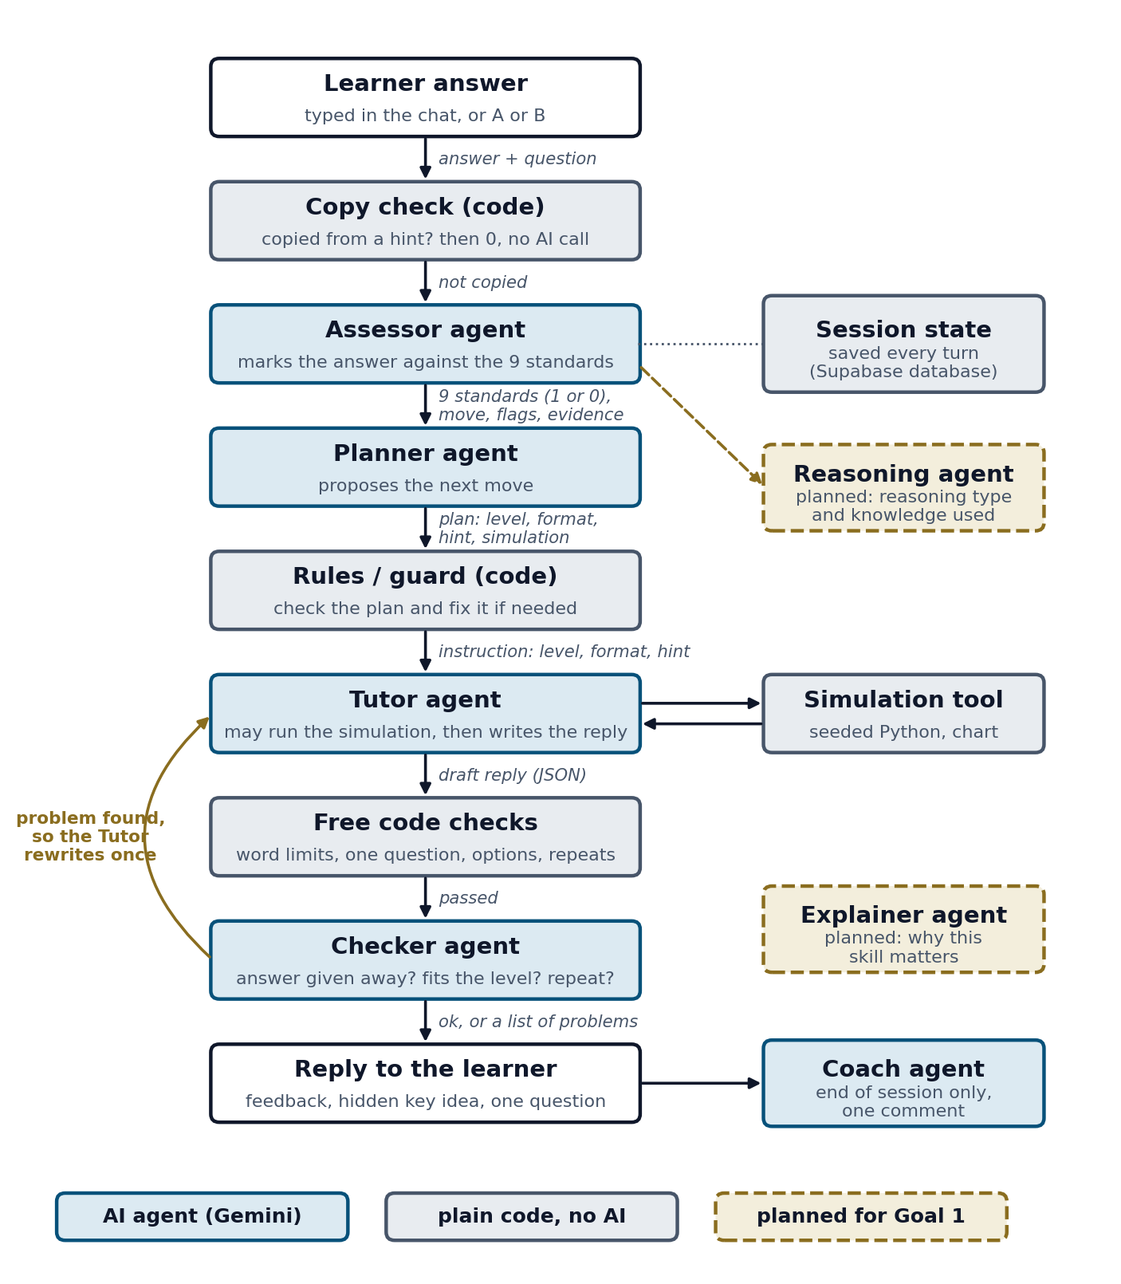
PROPOSED METHODOLOGY
System Architecture: Agents Decide, Rules Guard
1
Assessor: marks each answer, 9 standards as 1 or 0, with an evidence quote
2
Planner: proposes the next level, question format, hint and simulation
3
Rules (code): a frustrated learner always gets an easy A or B question; no level up after a weak answer
4
Tutor: short feedback, a hidden hint, one question; may run a quant simulation
5
Checker: stops replies that give away the answer or repeat a question
6
Coach: one comment at the end on how the learner answered
Each agent gets a small JSON payload built by code and must reply in a fixed JSON shape. About 25 AI calls per 6-round session.
12
Notes:
This is the heart of the system. Every answer goes through these steps. The Assessor marks it. The Planner proposes the next move. Then plain code rules check the plan, so the AI cannot break important rules. The Tutor writes the reply and may run a small simulation, and the Checker reviews it before the learner sees it. So the agents decide, and the rules guard.

Slide 13
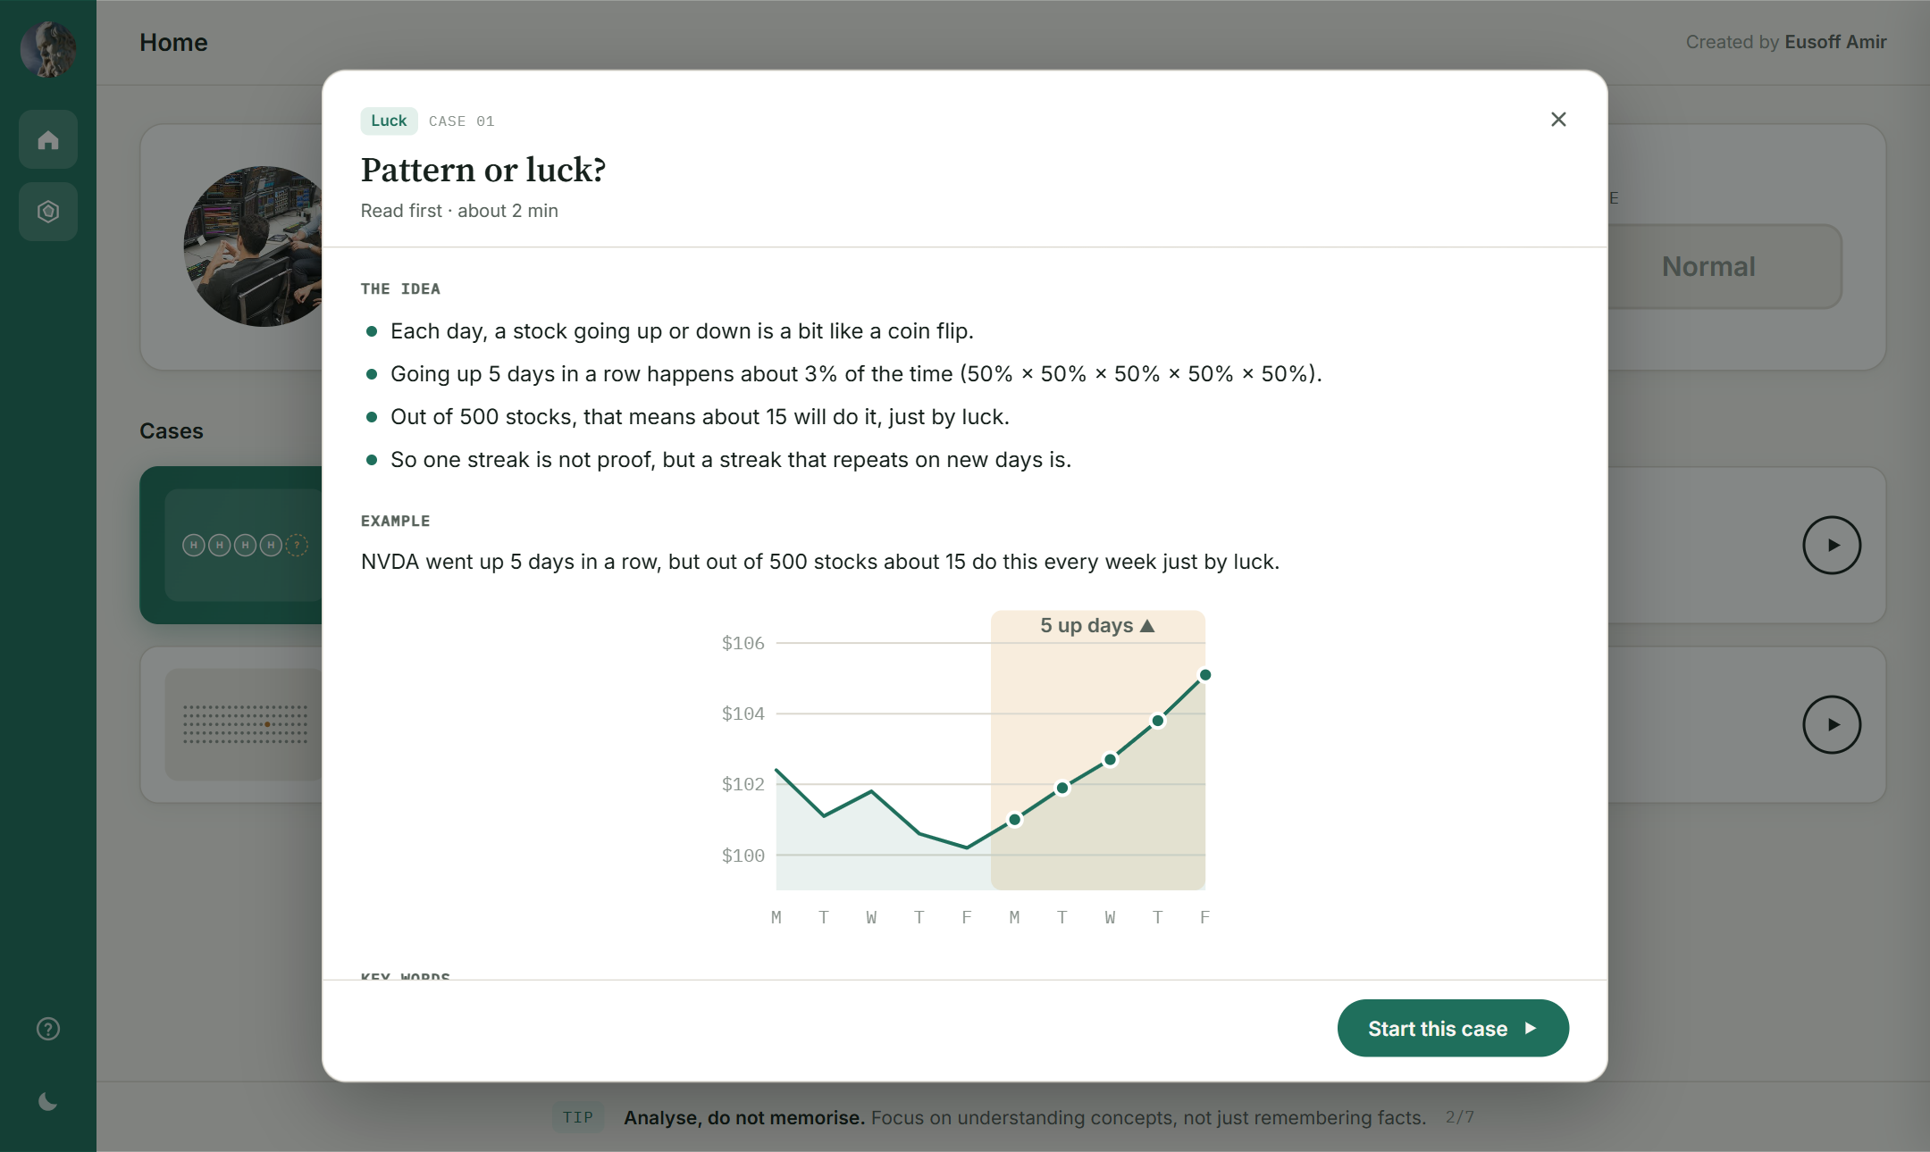
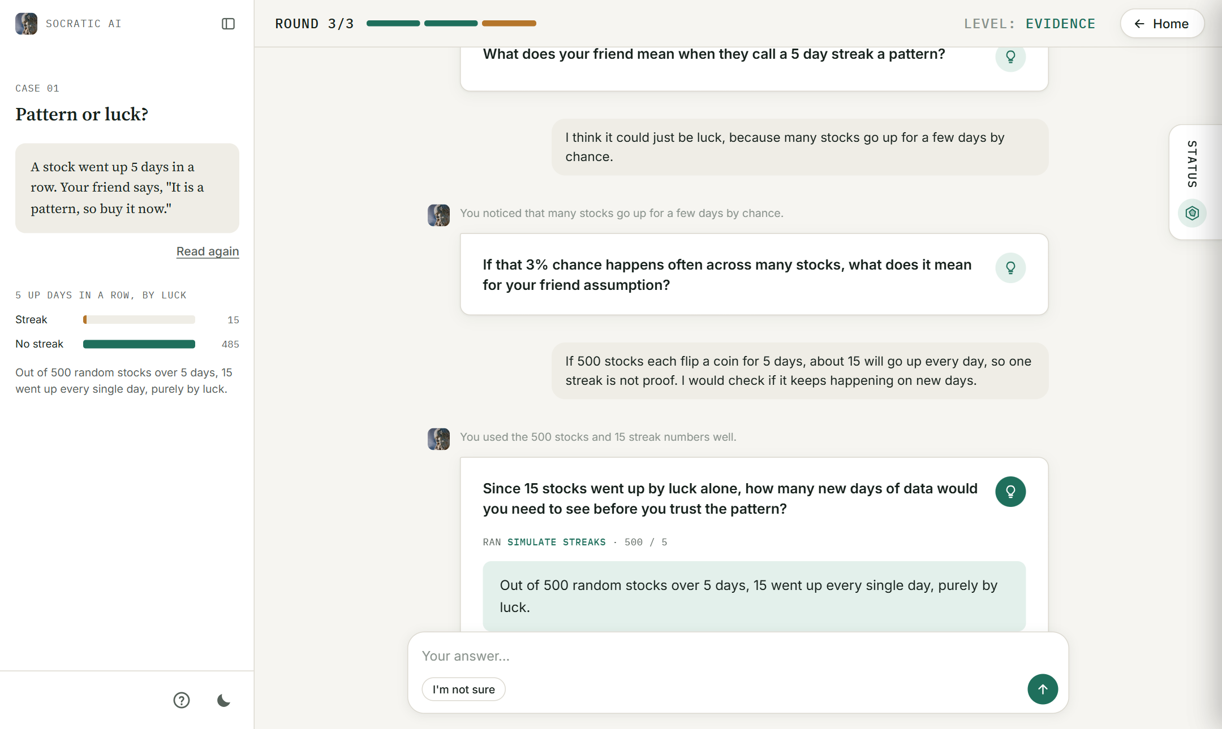
PROPOSED METHODOLOGY
Session Design (R1 to R9)
1. A short reading and a mission before each case
2. Feedback, one question, a hidden hint, and a simulation result
3, 6 or no-limit rounds
Round and level shown
4 question formats
"I'm not sure" button
Status panel
Tutorial
13
Notes:
This is what the learner sees. On the left, each case starts with a short reading. On the right, a real session: the tutor gives short feedback, one question, a hint that stays hidden until the learner opens it, and here it ran a simulation: out of 500 random stocks, 15 went up every day by luck. Underneath are the other features from the design requirements.

Slide 14
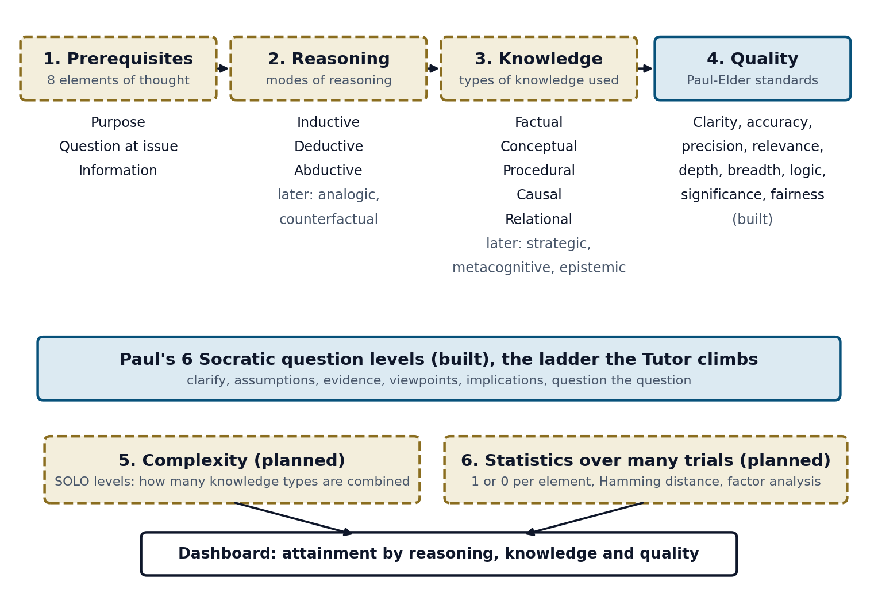
PROPOSED METHODOLOGY
Next Stage (Goal 1): Reasoning and Knowledge Layer
Knowledge layer: each case note tagged with its type of knowledge; an agent drafts a knowledge graph
Reasoning agent: 1 or 0 for inductive, deductive and abductive reasoning and each knowledge type, with evidence
Question bank: several questions per skill, so there are enough trials
Statistics: share of 1s and Hamming distance per learner [14]; factor analysis across learners
Explainer agent: a plain scenario on why a skill matters
Example: "All the regional banks fell, not just CIMB" is inductive reasoning on relational knowledge.
14
Notes:
From my last meeting, Dr Ho and I widened the framework. Navy parts are built, gold parts are planned. Besides quality, we want to know which type of reasoning the student used, like inductive or deductive, and which type of knowledge, like causal or relational. New agents will do this, without rebuilding the old ones. Each skill is measured over several questions, then simple statistics. For example, noticing that all regional banks fell, not just one bank, is inductive reasoning.

Slide 15
PROPOSED METHODOLOGY
Evaluation Plan
1
Requirement check
2
Assessor vs human markers
Run the same scenarios on the baseline Gem tutors and on Socratic AI, and mark R1 to R9 as met or not.
Mark 61 test answers by hand with a marking guide. Compare using percent agreement and Cohen's kappa per standard (parent grant target 0.8).
3
With and without agents
4
Learner experience
Switch the Planner, simulations or Checker off, and compare the same sessions.
A short questionnaire with Dr Ho's students, after ethics approval.
15
Notes:
I will evaluate in four ways. A requirement check against the baseline tutors. The Assessor against human markers using Cohen's kappa, where the parent grant targets 0.8. Switching agents on and off to see what each one adds. And a short questionnaire with real learners after ethics approval.

Slide 16
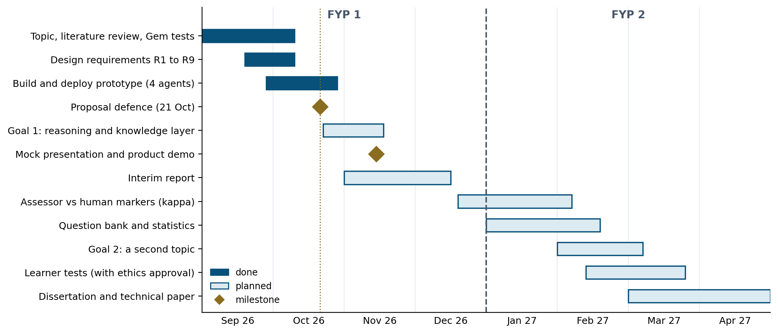
GANTT CHART & MILESTONES
Key Milestones
21 Oct 2026
Proposal defence
Mid Nov 2026
Goal 1 done, mock presentation
End of FYP 1
Interim report
FYP 2
Assessor validation, learner tests, second topic
End of FYP 2
Dissertation and technical paper
FYP 2 dates are a first plan, to be confirmed with the supervisor.
16
Notes:
This is my timeline. The dark bars are done: the tests, the requirements and the working prototype. By mid November I add the reasoning and knowledge layer, then the interim report. In FYP 2 I validate the Assessor with human markers, test with learners and try a second topic.

Slide 17
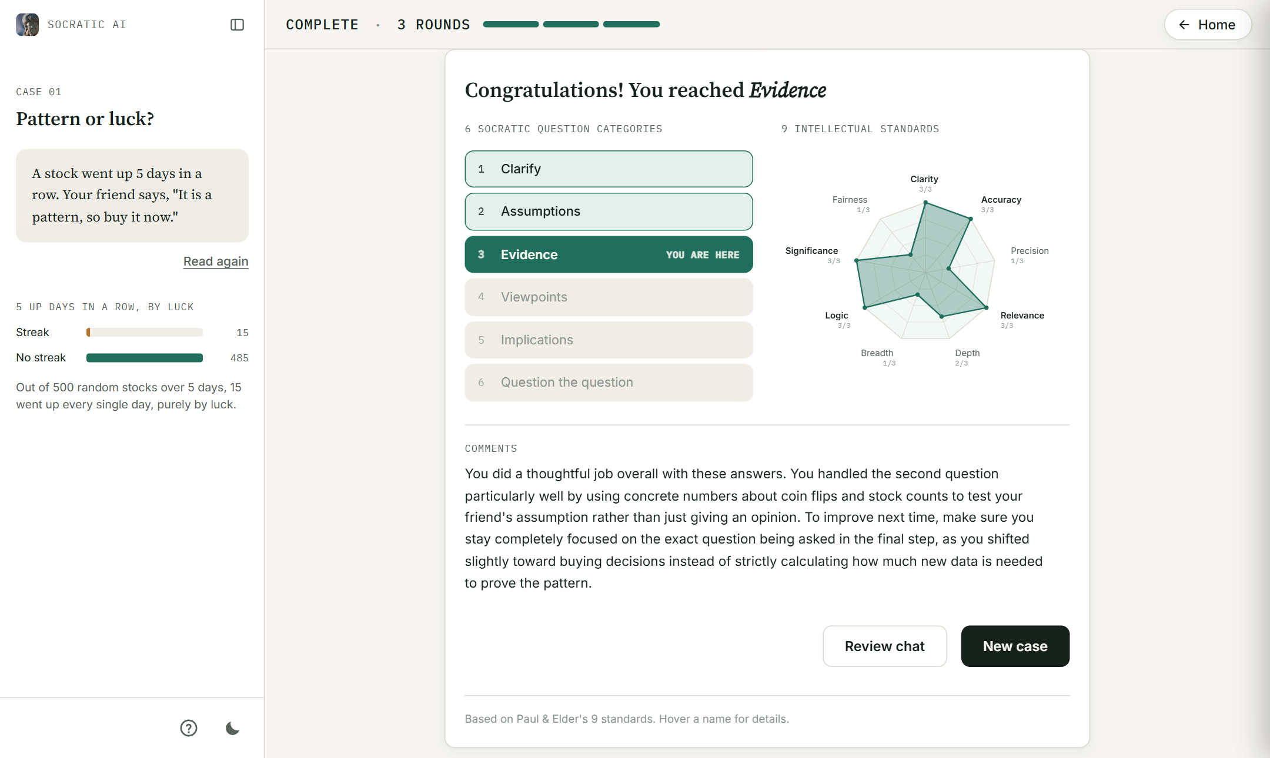
PRELIMINARY RESULTS
A Real 3-Round Session (Gemini)
0
times the answer was given away, even when asked to ignore the rules
5 of 5
problems found in testing were fixed
~24
AI calls per session, inside the free tier
End profile: level reached, the 9 standards chart and the Coach comment
17
Notes:
These are results from real sessions with Gemini. On the left is the end profile from a real 3-round session: the level reached, the nine standards and the Coach's comment. In my two full test sessions, the tutor never gave the answer away, even when I asked it to ignore its rules. I found five problems and fixed all five, and a session uses about 24 AI calls, which fits the free tier.

Slide 18
PRELIMINARY RESULTS
Assessor on a 61-Answer Test Set
Problems found and fixed
The welcome said there was no round limit: now written by code
The same question asked again in new words: the Checker now compares questions
The Planner's simulation was ignored: the rules now run it
Levels rose too fast: now 2 good answers in a row, or 1 strong answer
The Assessor was generous: strict rules per standard; standards met fell from 24 to 16 on 12 real answers
37 real answers from test sessions and 24 constructed answers. Not yet compared with human markers, so this is not a validation yet.
Next: keyword-only answers still score about 4 of 9, so the Assessor prompt is tightened again.
18
Notes:
I then ran the Assessor on 61 test answers. Strong answers met about 8 or 9 standards and trick answers about 1 or 2, which is the right direction. But answers that only repeat keywords still score about 4, so that is the next fix. These numbers are approximate and not yet compared with human markers. On the right are the five problems I found in testing and how each was fixed.

Slide 19
CONCLUSIONS
Generative AI makes it easy to skip thinking, and existing Socratic tutors have no structured question ladder, no assessment against a framework and no clear session. This project has built Socratic AI, a working multi-agent tutor that follows Paul's six question levels, marks every answer against the nine intellectual standards, and uses plain-code rules to guard every AI decision. First tests show it never gives the answer away and ends every session with a learner profile. The next stage shows which type of reasoning and knowledge a learner used, measured over many questions, and validates the Assessor against human markers.
Take-home message
This is a reasoning trainer, not an answer machine, built in a new way: many prompted agents working together, guarded by code.
19
Notes:
To conclude. AI makes it easy to skip thinking, and current tutors have no structure or real assessment. I built a working multi-agent tutor that follows the six levels, marks the nine standards and is guarded by code. Next I will show which type of reasoning and knowledge a learner used, and validate the marks against human markers. The take-home message: it is a reasoning trainer, not an answer machine, built in a new way with many agents working together.

Slide 20
REFERENCES
[1] R. Paul and L. Elder, The Thinker's Guide to the Art of Socratic Questioning. Foundation for Critical Thinking (year and edition to be confirmed).
[2] L. W. Anderson and D. R. Krathwohl, Eds., A Taxonomy for Learning, Teaching, and Assessing. Longman, 2001.
[3] J. B. Biggs and K. F. Collis, Evaluating the Quality of Learning: The SOLO Taxonomy. Academic Press, 1982.
[4] H. Sahamid, "Developing critical thinking through Socratic questioning," Int. J. Educ. Literacy Stud., vol. 4, no. 3, pp. 62-72, 2016.
[5] A. Makhene, "The use of Socratic inquiry to facilitate critical thinking in nursing education," Health SA Gesondheid, vol. 24, a1224, 2019.
[6] Y.-R. Ho, B.-Y. Chen and C.-M. Li, "Thinking more wisely: Using the Socratic method to develop critical thinking skills amongst healthcare students," BMC Med. Educ., vol. 23, 173, 2023.
[7] P.-B. Degen and I. Asanov, "Beyond automation: Socratic AI, epistemic agency, and ... multi-agent learning architectures," arXiv:2508.05116, 2025.
[8] F. Fan, "Socratic scaffolding in AI education: A framework for critical thinking," Regional Educ. Technol. J., vol. 8, no. 1, 2025.
[9] K. W. Lee, Y. S. Ang and J. W. Lai, "Learning analytics with scalable Bloom's taxonomy labeling of Socratic chatbot dialogues," Computers, vol. 14, no. 12, 555, 2025.
[10] H.-P. Lee et al., "The impact of generative AI on critical thinking," in Proc. CHI '25, Art. 1121, 2025.
[11] A. Sarkar, "How to stop AI from killing your critical thinking," TEDAI Vienna, 2025.
[12] L. Brand, "A practical guide to agentic AI in higher education," QS, 11 Sep. 2026.
[13] L. Yan et al., "Practical and ethical challenges of large language models in education," Br. J. Educ. Technol., vol. 55, no. 1, pp. 90-112, 2023.
[14] R. W. Hamming, "Error detecting and error correcting codes," Bell Syst. Tech. J., vol. 29, no. 2, pp. 147-160, 1950.
[15] P. Lewis et al., "Retrieval-augmented generation for knowledge-intensive NLP tasks," NeurIPS, vol. 33, pp. 9459-9474, 2020.
20
Notes:
These are my references. The full list is in my thesis.

Slide 21
THANK YOU
Q & A
Notes:
Thank you. I am happy to take your questions.

